Slide 1
Flow Aware Networking
Queue Model

Slide 2
Table of contents:
Traffic conditioning mechanisms
Scheduling mechanisms
Is it possible to implement DiffServ congestion solutions into FAN?
Fan Router
Priority Fair Queuing
Priority Deficit Round Robin
PFQ vs PDRR
What is the future?

Slide 3
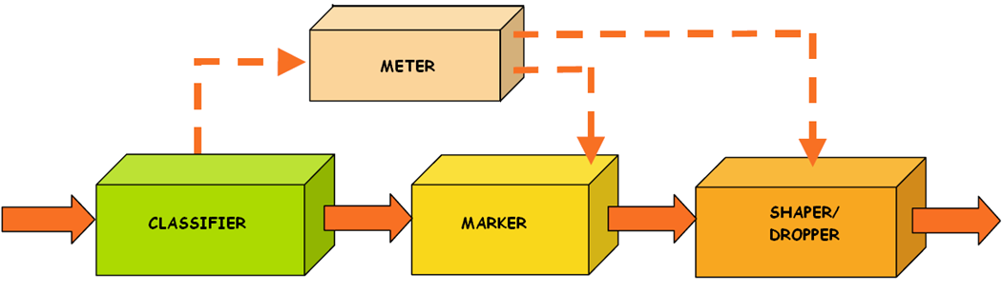
Traffic conditioning mechanisms
Traffic conditioning mechanisms| Scheduling mechanisms| DiffServ congestion solutions in FAN| Fan Router| PFQ| PDRR| PFQ vs PDRR| What is the future?
4 types of operation
The last mechanisms before scheduling
Notes:
Traffic conditioning mechanisms perform 4 types of operation:
a.) metering
b.) marking
c.) shaping
d.) dropping
The aim of the monitoring is to check if selected packet flow is compliant or non-complaint with assumed profile.
Packet marking may be performed on packet coming directly from classifier block, or on a packet coming from meter block.
The aim of this step is to set proper value of header fields, which are designed to hold that information. In case of DiffServ, marking means setting correctly DSCP fields in packet header. This allows packets to be served in proper way on every next level of service.
The last traffic conditioning block is shaper/dropper – its mechanisms allow to remove packets from network, which are not complaint with their declared traffic profile or which removal may influence and change traffic generated by packets source. In both cases the shaping/dropping process should support requirements specified for selected service in QoS.
The next step for all packets are scheduling mechanisms.

Slide 4
Scheduling mechanisms
Traffic conditioning mechanisms| Scheduling mechanisms| DiffServ congestion solutions in FAN| Fan Router| PFQ| PDRR| PFQ vs PDRR| What is the future?
Assures differential quality in routing packets assigned to different flows
Different packet types Different quality of service
Many algorithms (FCFS, PS, FQ etc.)
Quality
Selecting which packets should be sent first
Selecting which packets may be dropped
Notes:
In scheduling block packets are assigned to different queues, on their QoS class basis. Different packet types are assigned different quality, by simple selecting which packets will be sent first (packets moved to queue that has the highest priority) or selecting which packets may be dropped as first (which packets will be moved to queue with the lowest priority). Thus, we can specify 2 types of parameters for sending packets – packet delay, and packet loss ratio.
The important thing is the fact that scheduling is performed in each DiffServ router.
There are many different algorithms supporting queue managements - e.g. FCFS (First Come First Served – the other name for that algorithm is just FIFO), PS (priority scheduling), FQ (fair queuing), DRR (deficit round robin). Some of them, or their modifications will be presented on next slides.
Now its time to leave DiffServ and move to FAN.

Slide 5
Is it possible to implement DiffServ congestion solutions into FAN?
Traffic conditioning mechanisms| Scheduling mechanisms| DiffServ congestion solutions in FAN| Fan Router| PFQ| PDRR| PFQ vs PDRR| What is the future?
Differences in congestion control ideas:
DiffServ | FAN
AC, classifier, traffic conditioner, scheduler blocks | Only AC and scheduler blocks – cross protect router
Admission control performed only in edge routers | Admission control performed in every router
No information about flows inside router memory – QoS based on information about agregates | Router holds only flow list, without declaration info for traffic class
Domain agent Bandwidth Broker | No central agents
No info about network state hold in routers | Information based on measurements held in every router
Notes:
Although FAN derives advantage from many DiffServ solutions, both architectures are very different.
At first let’s look at the structure of basic router – there are no blocks like classifier or traffic conditioner in FAN, both solutions have Admission Control and scheduler blocks – FAN is much simpler.
Additionally, Admission Control block in DiffServ is only used in edge routers. The idea of cross-protect router in FAN results in Admission Control performed in each router, not only in edge ones.
The next main difference is a results of basic QoS attitude of both solutions – as mentioned before DiffServ is based on aggregates, while FAN assigns packets to flows. Because of that fact different type of information is held in both solutions. DiffServ needs to store info about the way to recognize and assign packets to different traffic classes, whereas FAN needs to hold the list of flows actually served.
When comparing both QoS mechanisms we cannot forget about the Bandwitdth Broker, which is an idea unique for DiffServ. There is not FAN domain centralized agent responsible for admission control process and negotiations with other domains. It is also very important while it holds the info about network state – the routers are not aware of traffic situation in whole domain. In FAN situation is opposite – no central agent, makes each router gather information about network, based on constant measurements.

Slide 6
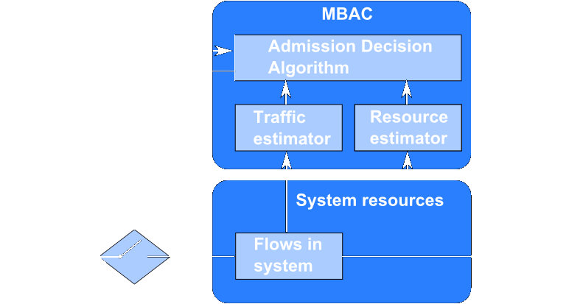
Measurement Based Admission Control (MBAC)
Traffic conditioning mechanisms| Scheduling mechanisms| DiffServ congestion solutions in FAN| Fan Router| PFQ| PDRR| PFQ vs PDRR| What is the future?
Notes:
In FAN networks, Admission Control in each node secures the proper conditions for every already registered flow in case of congestion. All the decisions about new incoming flows are made in this block – whether to service or reject requesting flow. Every flow, serviced currently by router is registered on special list – called PFL (Protected Flow List). If requesting flow is already on the list, all of its packets are serviced instantly, if not the admission decision algorithm is performed. If the link is currently under congestion and transfer of new incoming packets is impossible, then the flow is rejected. If the link is free (have enough bandwidth to service new flow), then it is accepted and added to PFL. This is also the way user gets information about congestion in network – in such a case his request for new flow is rejected.
But what about small amounts of data held in each router that we have talked about before? Is the PFL not getting bigger and bigger with each incoming flow? To prevent that situation, all the flows are monitored. If there is no packet with id from given flow for a while, then it is removed from the list.
There is still one more question about the way the router monitors links saturation. It is done actually by Scheduler block.

Slide 7
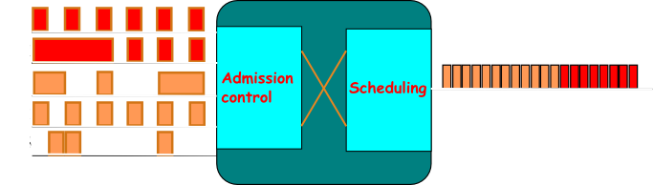
Cross-protect in FAN router
Traffic conditioning mechanisms| Scheduling mechanisms| DiffServ congestion solutions in FAN| Fan Router| PFQ| PDRR| PFQ vs PDRR| What is the future?
Incoming packets
Outgoing packets
Notes:
The implementation of both Admission Control and Scheduling mechanisms assures differentiation of quality for 2 types of traffic that are described in FAN. Measurements of link utilization are performed in a constant way in Scheduler part. All the decisions about accepting new flow are made on the basis of this link utilization and bandwidth per one flow in current PFL (which is also measured in scheduling block).
This way both mechanisms are strictly dependant – Admission Control block uses data from Scheduler to monitor the probability of packet loss, possible packet delay, and also the maximum bandwidth for the flow to be treated as stream. Scheduling provides also the AC block with the measurements of fair bandwidth – this is connected with proposed by the authors of FAN scheduling algorithm, called Priority Fair Queueing, which differentiates flows by their bandwidth – if it is bigger or lower than fair value.
This algorithm will be described and explained in the following slides.

Slide 8
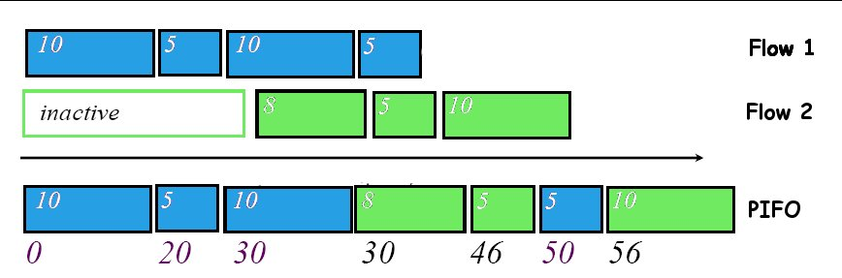
Priority Fair Queuing
Traffic conditioning mechanisms| Scheduling mechanisms| DiffServ congestion solutions in FAN| Fan Router| PFQ| PDRR| PFQ vs PDRR| What is the future?
Modified version of Start-time Fair Queuing
Push-In First-Out queue, each element has timestamp
Active Flow list
Virtual Time counter
Notes:
The PFQ algorithm is a modified version of Start-time Fair Queuing. Thus to explain PFQ we will start with SFQ.
A SFQ scheduler maintains the following data:
a.) PIFO queue –the list of packets to send stored in decreasing order of timestamps. Each packet upon arrival is assigned a timestamp, which is some kind of “start tag” based on SFQ algorithm. PIFO queue is the same as FIFO, the difference is that new elements may be put inside the list, not only at its end as in FIFO.
b.) Active Flow list (PFL) – the list of registered flows already in service. Each flow has its “flow timestamp” which we can consider as a “finish tag” of the packet currently serviced.
c.) Virtual Time – a counter which we can refer as current system time. The value of this counter is a timestamp (“start tag”) of the packet currently served
Let’s move to the example. We have two flows. The rectangles are packets. The numbers inside packets are they lengths. The arrow shows the time change, on the bottom of the picture one may see time points of simulation. The capacity of link is 0.5 packet/time unit. First blue packet will be sent in 20 time units, so the second blue packet “start tag” is 20 – because it’s the “finish tag” of last packet in blue flow. It will be sent in 10 units time so the “start tag” of third blue packet is 30 (20 + 10). The third packet will be sent in 20 time units (10/0.5). Thus, “start tag” of last blue packet is 50 (30 + 20).
But what about 2nd flow. As we said before Virtual Clock is equal to “start tag” of packet currently serviced. So when first blue packet was sent VT value is 0, when 2nd blue packet was sent the VT was 20, and so on 3rd – VC is 30, 4th – 50. When first packet of new flow is registered on the router, its timestamp (“start tag”) is equal to current VT value, so in our example it would be 30. Next packets are given “start tags” the same way as in case of 1st flow – based on “finish tags” of previous packets in their flow.

Slide 9
SFQ algorithm
Traffic conditioning mechanisms| Scheduling mechanisms| DiffServ congestion solutions in FAN| Fan Router| PFQ| PDRR| PFQ vs PDRR| What is the future?
Packet arrival: on arrival of l-byte packet p of flow f: if f is a registered in ActiveList do p.TimeStamp = f.FinishTag f.FinishTag += l else add f to ActiveList p.TimeStamp = VirtualTime f.FinishTag = VirtualTime + l | Packet departure: transmit packets in increasing TimeStamp order at the start of transmission of packet p: VirtualTime = p.TimeStamp for all flows f registered in ActiveList if (f.FinishTag < VirtualTime) remove f if no packets in scheduler VirtualTime = 0
Notes:
This is the algorithm of SFQ divided into packet arrival and packet departure. The fact we need to remember is that list of Active Flows is finite. We assume that packets of new flows that cannot be registered are put into PIFO queue with timestamp equal to Virtual Time. This is the required action, because if the ActiveList is not finite, it will be vulnerable to overflow.
As for packet departure algorithm – we need to remember about the following facts:
packets are sent in increasing timestamp order
Virtual Time is always set to “start tag” (timestamp) of currently serviced packet
Flows which “finish tag” (the “finish tag” of last registered packet of that flow) is lower than Virtual Time must be removed. It means that flows which all packets were already sent are removed from ActiveList
If all packets were sent, and there is no new one, Virtual Time is set to 0.

Slide 10
PFQ algorithm
Traffic conditioning mechanisms| Scheduling mechanisms| DiffServ congestion solutions in FAN| Fan Router| PFQ| PDRR| PFQ vs PDRR| What is the future?
Packet arrival: if PIFO congested, reject packet p at head of longest backlog if f is registered in flow list F if bytes >= MTU p.TimeStamp = f.FinishTag else begin p.TimeStamp = virtual time put behind P, update P f.FinishTag += l else p.TimeStamp = VirtualTime put behind P, update P if flow list is not saturated add flow f.FinishTag = virtual time + l | Main disadvantage: SCALABILTY Per packet computational complexity is O (logQ), where: Q – number of flows server by the router
Notes:
This is the PFQ simplified algorithm. The difference comparing to SFQ is a pointer P identifying the last of the priority packets at the head of the PIFO queue. This pointer is necessary to realize priority queuing, distinguishing between packets of backlogged and non-backlogged flows having the same timestamp. This is realized in lines 7 and 11.
The priority packets are recognized if the cumulative volume of transmitted bytes is less than the maximum packet size, MTU (step 3). However, If the flow is not active, the packet is given priority. It acquires virtual time and is inserted in the PIFO at the position indicated by P (same as for registered priority packets).
An internal counter keeps track of the total number of priority packets’ bytes for congestion measurement.
There is no sense in presenting the packet departure algorithm, while it is quite similar to SFQ.
So if PFQ a perfect algorithm? No it is not. Its main disadvantage is scalability – the computational complexity is logarithmic, what will be a main problem considering serving great number of flows. That is why the better concept may be to use PDRR, a modified version of Deficit Round Robin.

Slide 11
Priority Deficit Round Robin
Traffic conditioning mechanisms| Scheduling mechanisms| DiffServ congestion solutions in FAN| Fan Router| PFQ| PDRR| PFQ vs PDRR| What is the future?
Based on standard DRR
Per flow f state:
  f.Identier - the flow identifier (possibly a hash of the relevant header fields)
  f.Queue - current length in bytes of flow f queue
  f.Quantum - value of flow f quantum ( >= MTU bytes)
  f.Deficit - current flow deficit
  f.FIFO - addresses of head and tail packets of a linked list forming the flow f FIFO
  f.Next - the next flow in the DRR schedule following flow f
Notes:
PDRR, is a fair queuing algorithm that inherits the O(1) complexity and fairness properties of DRR while improving latency by the use of a priority queue for low rate flows.
Flows that need to be accounted for by the DRR scheduler are logged in a table called Active Flow List AFL (Protected Flow List PFL). Necessary per-flow state for a given flow f using DRR is:
Identifier – the unique flow ID
Queue – which is number of bytes of flow which need to be serviced
Quantum – this is kind of weight value assigned at the beginning to each flow
Deficit – current flow deficit calculated constantly on packet scheduling
FIFO – linked list of packets
Next – address of the next flow to be scheduled by scheduler
The simplified version of PDRR algorithm is presented on next slide.

Slide 12
Priority Deficit Round Robin simplified algorithm
Traffic conditioning mechanisms| Scheduling mechanisms| DiffServ congestion solutions in FAN| Fan Router| PFQ| PDRR| PFQ vs PDRR| What is the future?
Packet enqueue: If no free buffers left then dropPacket(); i = ExtractFlow(p); If (i is not registered in AFL) InsertActiveList(i); i.DC = 0; i.ByteCount = size(p); Enqueue(PQ, p) Else i.ByteCount += size(p); If (i.ByteCount <= i.Q) then Enqueue(PQ, p); Else Enqueue(i.Queue, p); | Packet dequeue: While (PQ not empty) do p = Dequeue(PQ); i = ExtractFlow(p); Send(p); i.DC -= Size(p); If (AFL is not empty) then Get head of AFL - flow i; i.DC += i.Q; While ((i.DC >= 0) and (Queue i not empty)) do PacketSize = Size (Head(i.Queue)); If (PacketSize <= i.DC) then Send(Dequeue(i.Queue)); i.DC -= PacketSize; Else break; RemoveActiveList(i); If (Queue i is not empty) then InsertActiveList(i);
Notes:
If on the arrival of a packet p the buffer is full, a packet must be selected for dropping (1-2). If packet p does not belong to an active flow, the flow is added to the current end of the AFL cycle and the packet is inserted at the tail of PQ (4-8). i.ByteCount keeps track of the number of bytes already inserted in PQ for flow i. A packet arriving to an active flow is given priority if i.ByteCount(i) <= i.Q (11-12); otherwise it is placed at the end of the flow queue (14). These operations (and the removal of inactive flows from AFL) ensure that packets of flows emitting less than one quantum per round realize have packet latency.
The dequeue operation extracts the packet at the head of PQ whenever it is not empty (1-3). When a packet is sent from PQ, the deficit counter of its flow is decreased by the packet size (3). This prevents more than one quantum being served during the same round. When PQ is empty and AFL contains at least one flow (4-5), the flow at the current head of the AFL cycle is selected for service and its deficit counter is incremented by one quantum (6). The last instructions (7-13) allow the flow to emit up to DCi bytes. The flow is removed from the schedule if it empties (14). Note that this will happen if the flow emitted less than its quantum in the current round or, in other words, if its rate is smaller than the current fair rate.

Slide 13
Deficit Round Robin simple example introduction
Traffic conditioning mechanisms| Scheduling mechanisms| DiffServ congestion solutions in FAN| Fan Router| PFQ| PDRR| PFQ vs PDRR| What is the future?
Traffic
Source 1
1200
Traffic
Source 2
800
Traffic
Source 3
1500
Quantum
1000

Slide 14
Deficit Round Robin simple example, round 1
Traffic conditioning mechanisms| Scheduling mechanisms| DiffServ congestion solutions in FAN| Fan Router| PFQ| PDRR| PFQ vs PDRR| What is the future?
Deficit | Packet served
1000 | No
1000 – 800 = 200 | Yes
1000 | No
Traffic
Source 1
1200
Traffic
Source 2
800
Traffic
Source 3
1500
Quantum
1000

Slide 15
Deficit Round Robin simple example, round 2
Traffic conditioning mechanisms| Scheduling mechanisms| DiffServ congestion solutions in FAN| Fan Router| PFQ| PDRR| PFQ vs PDRR| What is the future?
Deficit | Packet served | Deficit | Packet served
1000 | No | 2000-1200 = 800 | Yes
1000 – 800 = 200 | Yes | 0 | No
1000 | No | 2000–1500 = 500 | Yes
Traffic
Source 1
1200
Traffic
Source 2
800
Traffic
Source 3
1500
Quantum
1000

Slide 16
PFQ vs PDRR
Traffic conditioning mechanisms| Scheduling mechanisms| DiffServ congestion solutions in FAN| Fan Router| PFQ| PDRR| PFQ vs PDRR| What is the future?
Which solution is better?
PFQ:
-simple
-but higher computational complexity O(logQ) – not well scalable
PDRR:
-more complex, bigger amount of data to be held inside router
-computation complexity O(1) – very scalable, main FAN feature over DiffServ
Notes:
There is no simple answer about the winner of scheduling algorithm match, both solutions have pros and cons. PFQ is simple, but computational effort is to big – there is a risk of no scalability – which is very important for FAN. PDRR is more complex in implementation, however computational effort is very attractive, and allows the solution to be scalable – what is the main feature of FAN, that should encourage IT specialists to move away from DiffServ.
Of course we cannot forget that there are many other scheduling algorithms, that also could be well implemented in FAN (after small modifications).
The concept of this QoS solution is not yet complete, so there it is still possible to find something new.

Slide 17
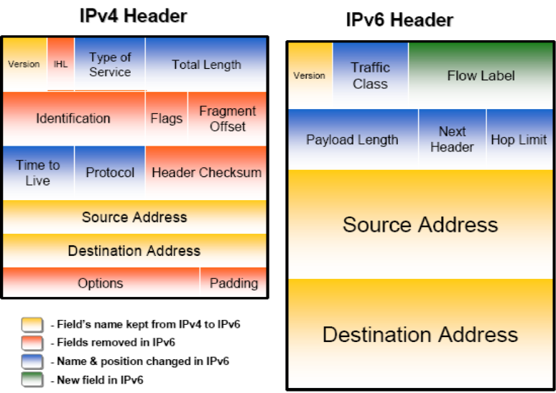
What is the future?
Traffic conditioning mechanisms| Scheduling mechanisms| DiffServ congestion solutions in FAN| Fan Router| PFQ| PDRR| PFQ vs PDRR| What is the future?
Redesign of IPv6 packet
Minimized header overhead and reduced header process for the majority of packets
Less essential fields removed or moved to extension headers
Traffic class in IPv6= TOS in IPv4
New Flow Label
Notes:
The IPv6 is the internet future. We often hear about solutions that are ready for IPv6, however the overall speed of transition from IPv4 to IPv6 Is rather slow. Despite that fact, we may be sure that this is the future solution. And what are the differences?
The IPv6 packet was redesigned, to better address the need of next generation internet. In the picture we can see major changes – minimized header overhead, and the removal of less important fields. TOS from IPv4 was changed into Traffic Class field, which holds the same function, but is twice bigger (8bits).
A very important change was made by introducing Flow Label, a 20-bit field defining the packets of the flow. It is selected by the source and never modified in the network. What is more important – is the fact that flow label is defined before address, in case a flow routing is used (in this case the route is calculated only once). This is also a very important field for us, it will strongly support idea of Flow Aware Networking. It will also allow routers to improve speed, and reduce queuing delays. There is also a question of implementation of QoS that will be implemented in future internet.

Slide 18
Thank you

